Slide 1

Ready Player Two
Connecting gamers Together

Slide 2
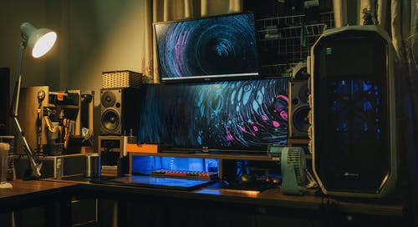
Gaming a hobby, we all enjoy

Slide 3
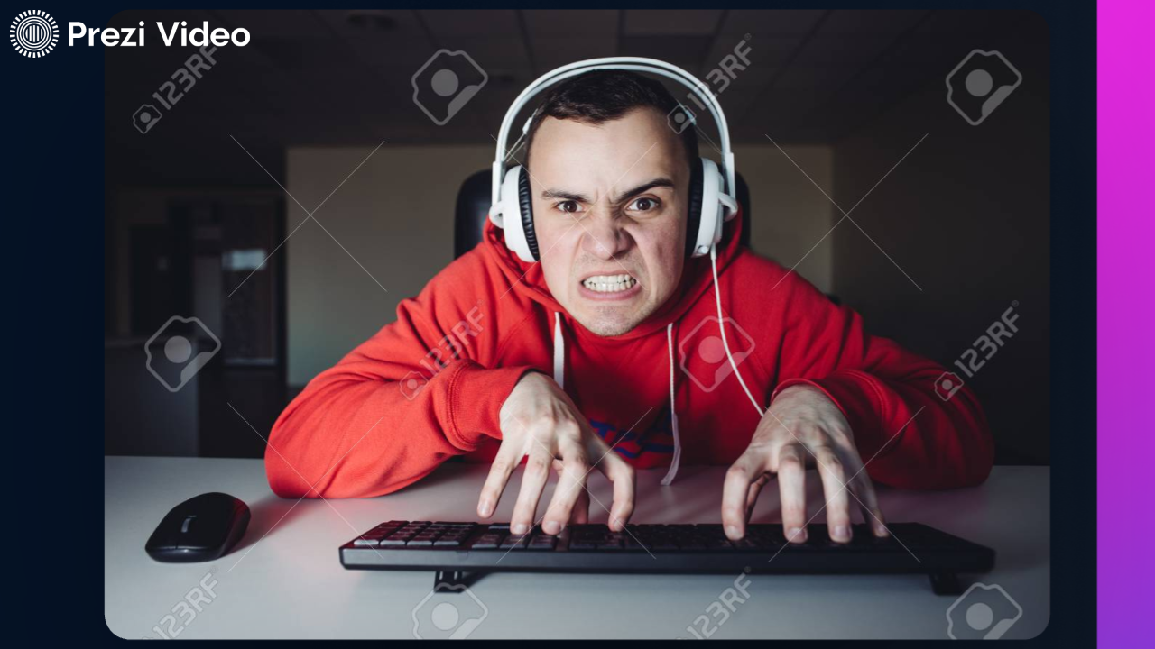
A problem we have all faced team finding!!

Slide 4
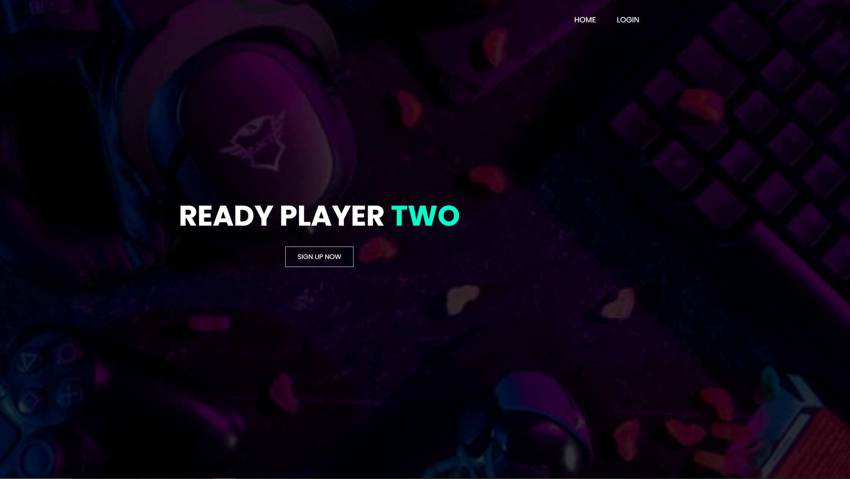
We have created Ready Player Two, A website for gamers, by gamers dedicated to connecting gamers

Slide 5

Web-based service so that no bulky or space consuming downloads are required

Slide 6

We got bigger and better things coming!!!!!

Slide 7
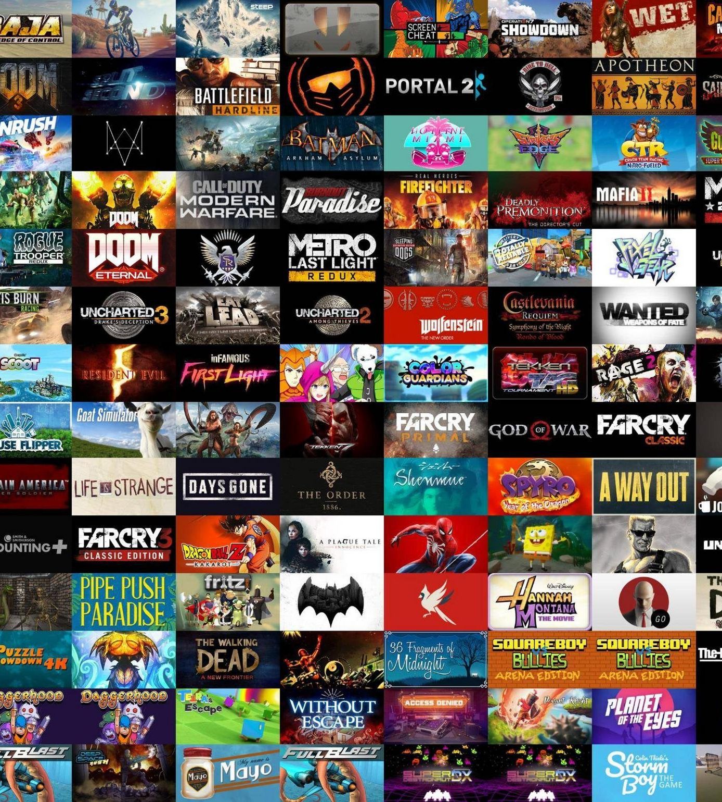
We plan to expand the limited compatibility of our product to all games currently in market

Slide 8
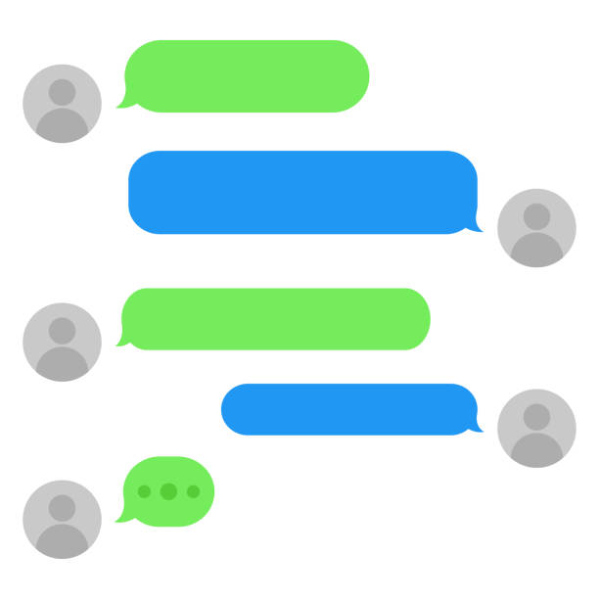
Within a six-month period, an inhouse messaging application

Slide 9
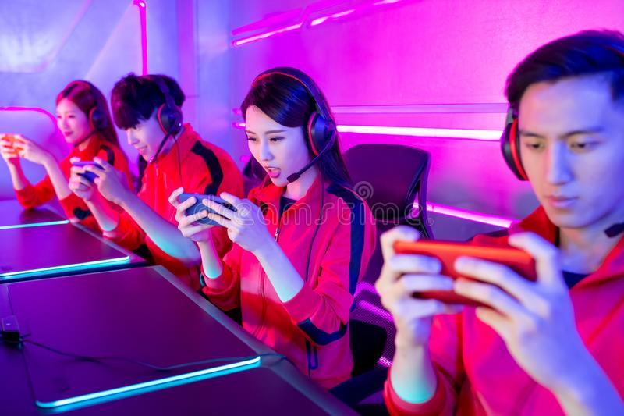
What are u waiting for? Hop on now to discover your new team!!!!!!

Slide 10
